Slide 1
Exploratory Data Analysis (EDA) for Real Estate Pricing
Organization : NextHikes IT Solutions
Presented By : Ankita Babar

Slide 2
Introduction -
The real estate market is highly dynamic, and house
prices are influenced by several factors such as location,
size, quality, and available amenities.
Understanding how these factors affect property prices is
essential for making informed business and investment decisions.
This project uses Exploratory Data Analysis (EDA) techniques to study
housing data and identify the key variables that impact house prices.
Through data visualization and statistical analysis.
the project aims to uncover patterns, trends, and relationships that help
explain price variations in the real estate market.

Slide 3
Challenges Faced During the Project -
Presence of many missing values
Mixed numerical and categorical data
Outliers affecting data distribution
Large dataset causing slow processing
Errors while plotting graphs

Slide 4
How I Overcame Them:-
Used median/mode for missing values
Fixed library and datatype issues
Filtered numerical columns for correlation analysis
Detected outliers using IQR and boxplots
Performed step-by-step analysis to avoid errors

Slide 5
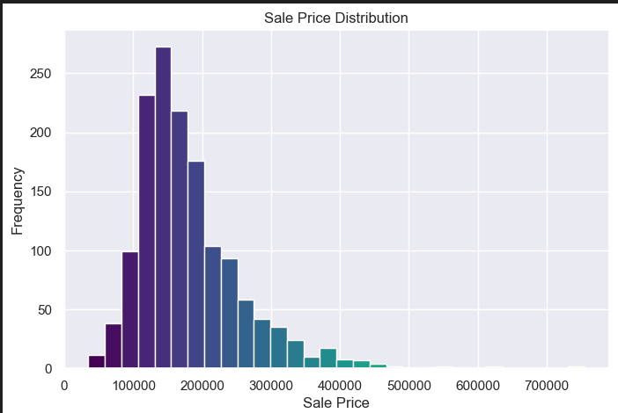
Univariate Analysis :-
Insights:
Sale prices are right-skewed, meaning most houses fall in a lower price range.
Few houses have very high prices, indicating premium or luxury properties.
Presence of extreme values suggests potential outliers.

Slide 6
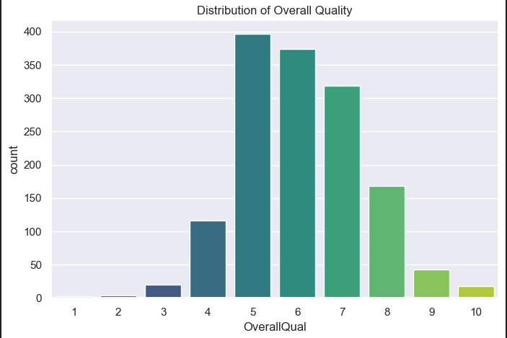
Univariate Analysis :-
Insights:
Most houses have moderate living area.
Very large houses are rare (outliers).
Larger living area increases property value.

Slide 7
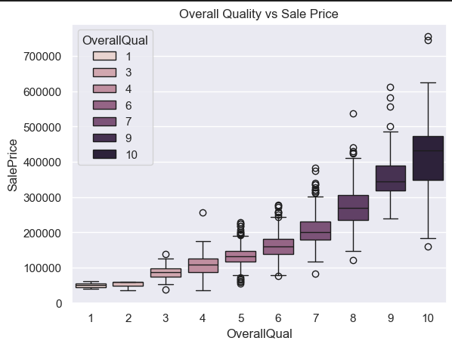
Bivariate Analysis :-
Insights:-
Sale price increases sharply with quality.
Quality is one of the strongest price drivers.
Premium houses show higher price variation.

Slide 8
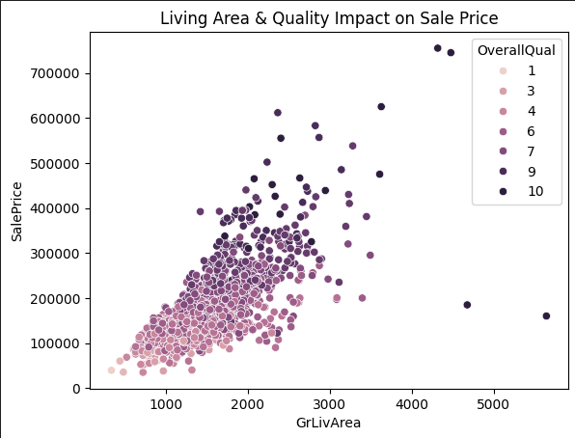
Multivariate Analysis :-
OverallQual + GrLivArea + SalePrice
Best price prediction combination:
High quality + large living area = premium price.
Insights :-
Houses with high quality and large living area have the highest sale prices.
Larger ground living area leads to higher prices.
Combined effect explains pricing better.

Slide 9
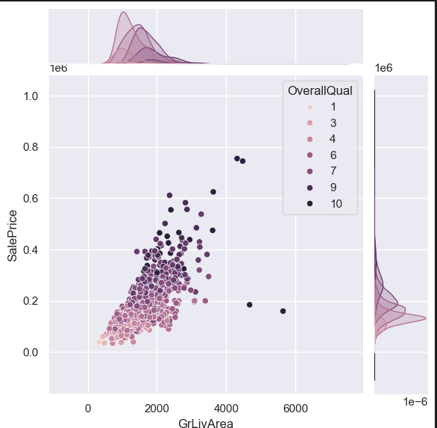
Joint Plot :- GrLivArea vs SalePrice
Insights:-
Dense regions show most common combinations of living area and price
Higher density shifts upward for better quality houses
Indicates a strong positive relationship between living area and sale price
High-quality homes cluster at higher price ranges

Slide 10
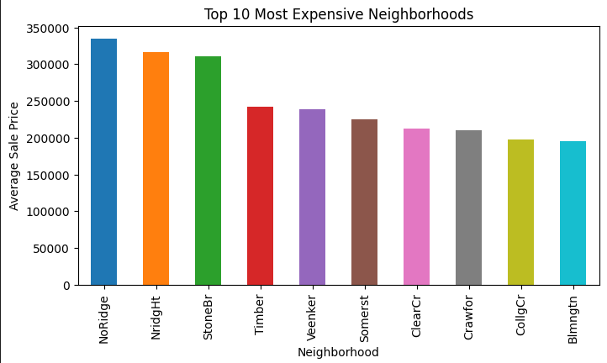
Neighborhood vs Average Price (Ranking):-
Insights:
Location plays a critical role in pricing.
Helps in investment & acquisition decisions.
A few neighborhoods stand out with significantly higher prices, suggesting premium demand.
This bar chart shows the top 10 neighborhoods with the highest average sale prices.

Slide 11
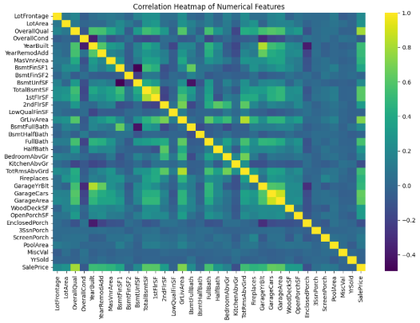
Correlation Heatmap of Numerical Features:-
Insights:-
Sale Price is strongly correlated with:
1.Overall Quality
2.Living Area
3.Garage Area
Pool Area shows weak correlation due to limited data.
Most numerical features shows low to moderate correlation
House price is most strongly influenced by quality, living area, and garage related features

Slide 12
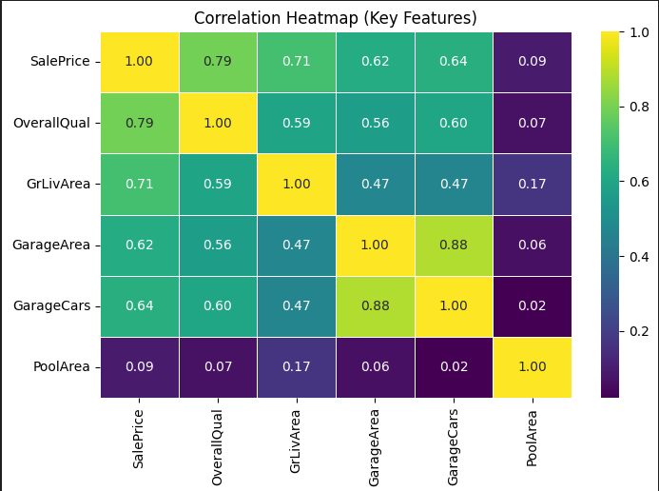
Correlation Heatmap(Key Features):-
Insights:-
Sale Price has strong correlation with OverallQual and GrLivArea.
GarageCars and GarageArea also positively impact price.
Some features show low or no correlation, meaning minimal impact on price.
Overall quality, living area, and garage features are the strongest drivers of house prices.
Some features show low or no correlation, meaning minimal impact on price.

Slide 13
Steps You Have Been Through:-
Problem Understanding
Data Collection
Data Cleaning
Data Exploration
Univariate Analysis
Bivariate Analysis
Multivariate Analysis
Correlation Analysis
Visualization
Insight Generation

Slide 14
Key Insights From the Dataset:-
Insights:-
Houses with larger garage areas tend to have higher prices
Pool area has a positive impact on house prices
Outliers significantly influence price distribution
Location and size play a major role in pricing

Slide 15
Conclusion:-
EDA helped understand data patterns and relationships
Data visualization improved insight generation
Clean data leads to more accurate analysis

Slide 16
Thank you!

